Slide 1
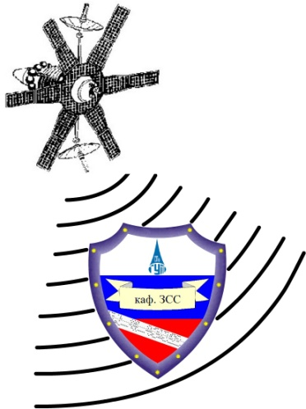
Introduction to
Secure Coding

Slide 2
Agenda
Roll Call
The Threats
Goals and Principles of Application Security
Introduction to Common Weakness Enumeration (CWE)
Security Mechanisms
Authentication
Authorization
Data Validation
Session Management
Error Handling
Logging
Encryption

Slide 3
Introduction

Slide 4
Application Security Threats
Script Kiddie
Leveraging tools and exploits created by others
Hacking by pushing the big red shiny button
Hacktivist
Hacker with a cause
Denial of service, site defacement
Hacker
Malicious and non-malicious
Because they can
Cyber Criminal
Different levels of sophistication
Scams, information theft, fraud
Advanced Persistent Threat
Extremely sophisticated attackers; nation-states
Low & slow, information theft, espionage
Notes:
There are many different threats to our applications that come from many different actors. These range from inexperienced kids looking to have some fun to powerful nation states looking for a political or military advantage.
Script kiddies are the least experienced individuals and are often more of nuisance then a malicious threat. They are motivated by the learning experience and not usually after something of value. They leverage existing exploits and usually need tools to do all the work for them. Keeping systems patched is often enough to keep the script kiddies away.
Hacktivists are slightly more advanced but still are not usually out for personal gain. They want to send a message by taking a site down or defacing the home page. Granted, the loss in dollars of such actions can be extraordinary to some businesses. Hacktivists will usually move on to other targets if the applications are not easy to break.
A hacker is the start of truly skilled attackers. They usually have spent years developing their trade and often craft some very tricky exploits. Yet hackers are usually motivated by the advancement of their skills and fame. They are not in it for serious monetary gain.
Cyber Criminals are much more motivated than your typical hacker. They often employee teams of individuals and have resources that are well beyond those of hackers and hacktivists. They know how to link different exploits together and are hard to stop. Of course the bigger concern is that they usually target a specific application and will work until they find a way in.
The advanced persistent threat (APT) is the top of this food chain. Often driven by nation states, the APT has unlimited resources and involves the best of the best in the world of hackers. They have specific targets and, unlike the previous groups, they will not be easily deterred by the challenge and move on to an easier target. Rather they will fight until they succeed. This makes the APT hard to stop. An application that may be of interest to the APT should be heavily scrutinized, reviewed, and monitored.

Slide 5
Application Security Goals
C
onfidentiality
Information is only available to those who should have access
I
Data is known to be correct and trusted
ntegrity
A
Information is available for use by legitimate users when it is needed
vailability
Notes:
Application security is typically treated in terms of three separate goals: Confidentiality, Integrity, and Availability. All three must be achieved for an application to be considered secure.
Confidentiality involves making sure that information in the application is only seen by those that should see it. Improper authentication, unauthorized access, information exposure all lead to a breach of confidentiality. The more sensitive the information held within an application, the more serious this goal is.
Integrity involves making sure that information is correct and hasn't been altered. The more important the role of the application, the more important it is for its information to be trusted as decisions are made based on this information. If a malicious user can change the information, then they can affect the decisions being made.
Availability is concerned with the ability of a user to access the application and complete their mission. If the information in an application is not available, then decisions that are based on this information can not be made.

Slide 6
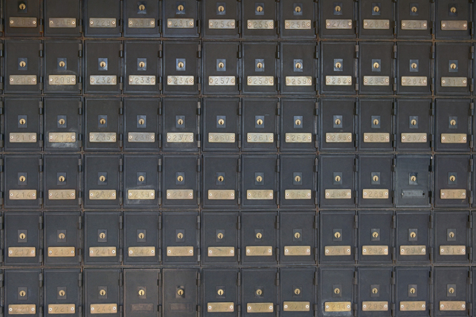
Principle – Minimize Attack Surfaces
More points
of interaction
More difficult
to defend
Notes:
The first application security principle is to minimize the attack surface. The more places that a malicious user can interact with an application (usually the inputs to the application), the more places that a developer has to put defenses in place. If an input type is not needed, then don't allow it. If an application doesn't need to listen on a given port, then don't let it. If all user input can be collected in one place and then retrieved, this beats collecting the information at varying points within an application. The less opportunity that a malicious user has to interact, the easier it will be to focus development effort on those places where the attacker can interact and to create a sound set of defenses.

Slide 7
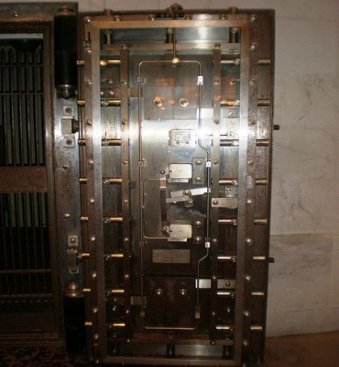
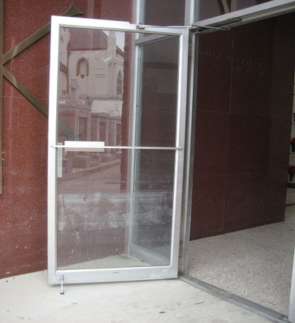
Principle – Establish Secure Defaults
Never rely on someone needing
to specially configure or enable
basic security functionality.
vs.
Notes:
The second principle is to make sure that the default state is secure. Installation may be performed by an unqualified individual, or by someone without knowledge of how the application will be used and what information it will contain. In addition, the person installing an application may assume the user will configure, and the user will assume that the admin configured, resulting in no one configuring the application. Make sure that people must consciously make changes if those changes will reduce the security of the application. For example, force them to open a port to allow communication instead of relying on them to close a port if communication is not needed.
Don't prop the front door open assuming the person behind you will shut it. What if that person never comes or was home sick that day?

Slide 8
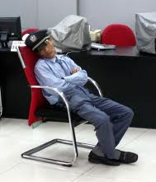
Principle – Least Privilege
Not everyone should have access
to everything.
Even people or accounts you
might think should have access
don’t always need it.
Notes:
The next application security principle is to understand that not everyone needs access to everything all the time. As developers we need to understand who needs access and only give it to those individuals. This is a key defense-in-depth principle. If a malicious user is able to penetrate your defenses, make sure that they don't get the keys to the kingdom.
Do the security guards really need keys to the vault? Most likely they only need access to the area around the vault. Make the attackers job harder by forcing them to manipulate the security guard AND the manager. For the few times that a security guard may need to get into the vault, have them ask a manager for access.

Slide 9
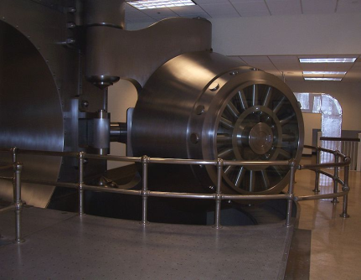
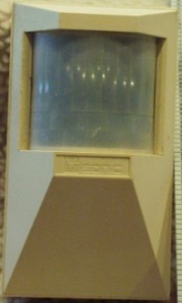
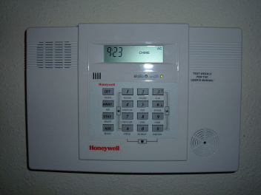
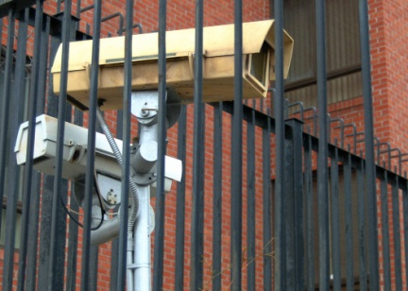
Principle – Defense in Depth
Don’t rely on a single security
method to protect everything.
Layer basic security practices
to ensure the overall safety of
an application.
Notes:
The next principle is defense in depth. Similar to least privilege, you don't want to rely on just one security mechanism, but rather layer multiple defenses on top of each other. That way if one mechanism fails, then an attack will still be stopped by a different defense.
For example, a bank does not just lock its front door. Bankers also lock the vault, have security guards, use motion detectors, etc. An attacker needs to defeat all of these defenses in order to achieve their goal. The same needs to be true regarding applications. Don't just rely on a login. Also implement least privilege, logging, data validation, etc.

Slide 10
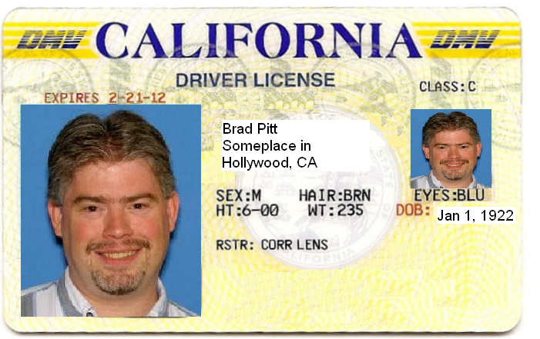
Principle – Fail Securely
Security controls should be
designed to fail until they are
proven valid.
When a security control does fail, it should place the application in a secure state.
Notes:
Another application security principle is to fail securely. Security controls should assume an attack by default and only let something pass if it is proven not to be an attack. By taking this approach, holes that we forget to cover will not lead to a valid attack, but rather to a bug report.
For example, showing a cop the license above should fail since Larry is obviously not Brad Pitt. But this failure should not result in Larry getting away with the crime. The failure should occur before person in custody is released. Failure after release means that there is no way of knowing who the person really is.
In addition, WHEN a security control fails, the application should revert to a secure state.

Slide 11
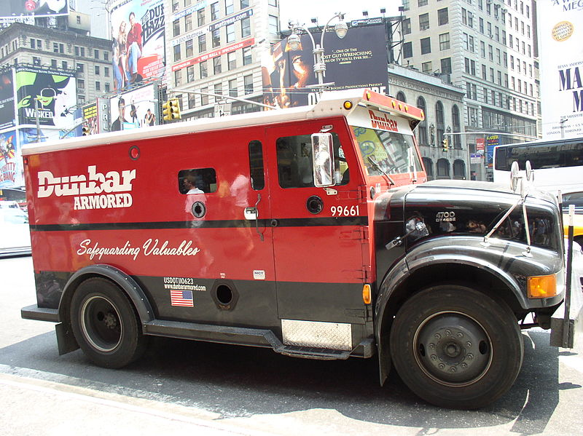
Principle – Don’t Trust Services
Don’t make assumptions that
can impact your application’s
security goals.
Notes:
The next application security principle is not to trust 3rd party services. Just because a service claims to do something right, doesn't mean it actually does. Inherently distrust data being returned from a 3rd party. You don't know the quality of development, the adherence to best practices, or the motivations behind the developers of 3rd party services.
You wouldn't just give all your money to a person driving an armored truck, rather you would first verify that the truck isn't a fake and hadn't been hijacked.

Slide 12
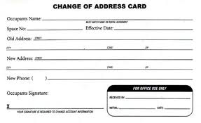
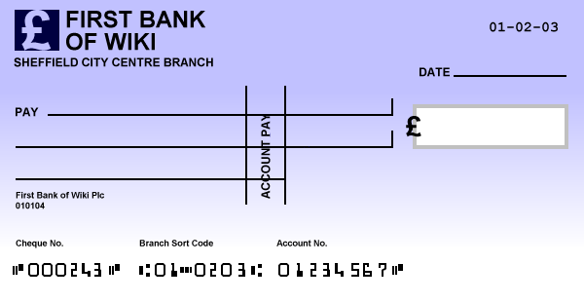
Principle – Separation of Duties
Change of Address
Authorize a Check
Some combinations of permissions don’t work
well together.
Notes:
Another application security principle is separation of duties. Ideally you want to split the roles for actions related to a security decision. You want to avoid having a single group being responsible for everything. This difference in responsibility adds to an application's defense in depth as both groups or roles must participate in a given attack.
Using the bank example again, you would not want the same person to be able to change the address of an account and also authorize a check to be cut against that account. Otherwise, an attacker who found a way to impersonate that person could change the address to their own, authorize a withdrawal, and then change the address back. A more secure approach would be to have one group handle change of address requests and a separate group be responsible for authorizing checks.

Slide 13
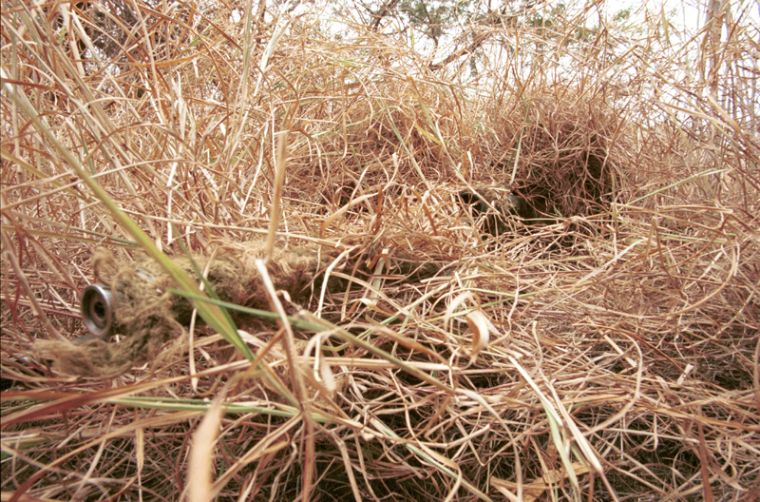
Principle – Avoid Security by Obscurity
“But an attacker would never know or see that!”
Notes:
Another application security principle is to avoid security by obscurity. Hackers, criminals, and the advanced persistent threat most likely can reverse engineer your source code, or find things that are supposedly hidden. Relying on obscurity is dangerous and is usually just a cover for real security not being implemented.
It is better to assume the attacker has all your secrets and then devise security mechanisms that protect the application in the face of this reality.
For example, the warfighter might be hidden from a typical attacker, but one with heat sensitive goggles would have no problem getting past the camouflage.

Slide 14
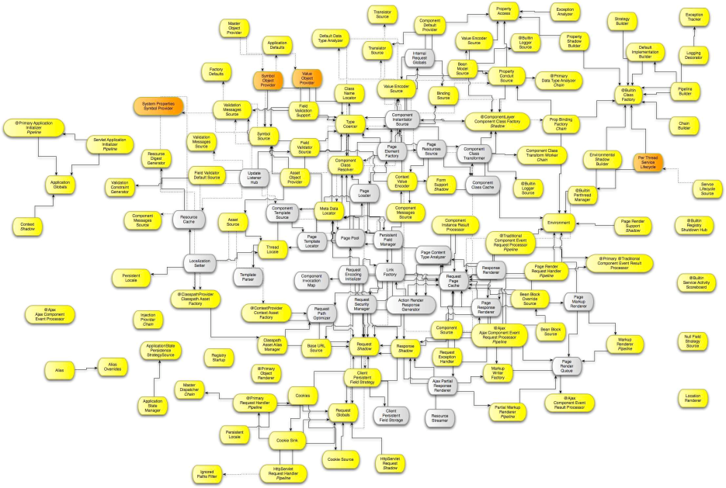
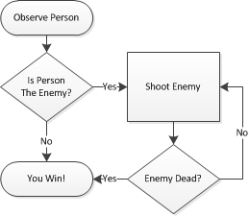
Principle – Keep Security Simple
vs.
The simpler the design of the security,
the easier it is to understand and
implement correctly.
Notes:
This principle is keep security simple. All too often a developer will over-engineer security and end up adding things that aren't necessary and introducing errors due to the complexity. The goal should be to design a security architecture that works, yet in the simplest way possible. Added complexity will not only make it harder to implement, but it will make it harder for a peer or a security team to review.

Slide 15
Principle – Fix Security Issues Correctly
Symptom
The real problem
Notes:
The final application security principle is to fix security issues correctly. This sounds a bit funny, but people often are made aware of an attack and put in a mechanism to stop that specific attack without fixing the underlying problem. A malicious user just changes the attack and is back inside the application.
As a developer you need to fully understand the problem before trying to engineer a fix.

Slide 16
Security Mechanisms
The gears that drive the
engine of application security.
All mechanisms must be used
correctly to ensure proper
security functionality.
Notes:
In the end, secure coding really comes down to the different mechanisms that are available to ensure adherence to the previously mentioned application security principles. The rest of this class will discuss these different mechanisms, breaking each down into a number of "words to live by".
These words to live by should be reviewed at the start of each project and be a part of the security design that kicks off a development effort.

Slide 17
Security Mechanisms to Achieve Goals
C
Authentication
Authorization
onfidentiality
Session Management
I
Data Validation
Error Handling
ntegrity
A
Logging
Encryption
vailability
Notes:
The security mechanisms that we will cover are:
- Authentication
- Authorization
- Data Validation
- Session Management
- Error Handling
- Logging
- Encryption
These security mechanisms each map back to our high level application security goals and enable us to sufficiently meet all three goals.

Slide 18
http://cwe.mitre.org
Notes:
One project that everyone should be aware of, and a project we will mention a lot throughout this course, is the Common Weakness Enumeration (CWE). This is a MITRE-run initiative to enumerate and provide standard identifiers for the different coding-level security-related mistakes that developers often make. This standard identifier enable security personnel to share information about weaknesses and for tools to report findings in a way that review teams can easily grasp.
Each of our words to live by is presented in terms of CWE and it is recommended that everyone take some time to review these specific CWE entries.
The CWE team also compiles a Top 25 list each year that helps identify the 25 most dangerous and prevalent software errors that we see today. This list is a great way to keep the most common issues in the forefront of a developer's mind and help focus effort to make sure that these errors are not introduced.

Slide 19
Authentication
Authorization
Session Management
Data Validation
Error Handling
Logging
Encryption
Security Mechanism:
Authentication

Slide 20
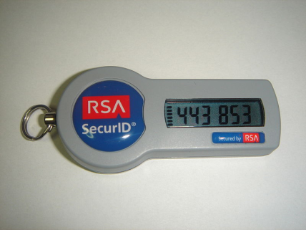
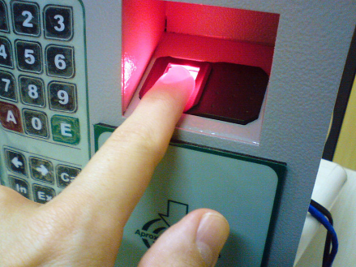
Authentication Core Concepts
A manner for identifying a user is who they claim to be.
Something you
know
Something you
have
Something you
are
Two-Factor Authentication
Leverage two of these methods for a single authentication transaction.
Notes:
Authentication is the act of confirming that someone (or something) is who they say they claim to be. The most common authentication that we do in our applications is confirming that a user is in fact who they claim to be, and not an imposter claiming to be someone they aren't. The ways in which someone may be authenticated fall into three categories, based on what are known as the factors of authentication: something you know, something you have, or something you are. For information or functionality that requires a heightened level of protection, two-factor authentication is common. This uses two of the three factors during the authentication process. Many use a combination of passcode and SecureID.

Slide 21
Authentication Words to Live By
Enforce basic password security
Implement an account lockout for failed logins
“Forgot my password” functionality can be a problem
For web applications, use and enforce POST method
Notes:
A we go through this class, for each security mechanism we will call out a set of "words to live by". It must be noted that these lists are not intended to be the "only" words to live by. Rather, they represent the most basic points and many of them represent what we find lacking during our reviews of source code. Given that we only have one day for this course, we have chosen to focus on these few important points.
As a developer, there are four key things to focus on related to authentication. First is to correctly enforce basic password security. In short, don't let your users enter "123" as their password. Second, to guard against brute force attacks on your login functionality, be sure to implement some sort of account lockout after a set number of failed attempts. Third, pay attention to how the forgotten password functionality is implemented. Getting this right is just as important as getting your login functionality right. Finally, when web applications need to pass sensitive data, always use and explicitly enforce the POST method. We will now delve deeper into each of these.

Slide 22
Authentication Words to Live By: #1
Enforce basic password security
CWE-521: Weak Password Requirements
The product does not require that users should have strong passwords, which makes it easier for attackers to compromise user accounts.
Minimum length enforcement
Require complex composition
Should not contain the user name as a substring
Users must be able to change password
Consider password expiration over time
Prevent reuse of some previous passwords when changed
Notes:
The first of our words to live by related to authentication is "enforce basic password security". This corresponds to CWE-521 titled "Weak Password Requirements". This includes things like adequate password length, enforcement of complex character combinations, password expiration, and preventing reuse of previous passwords.

Slide 23
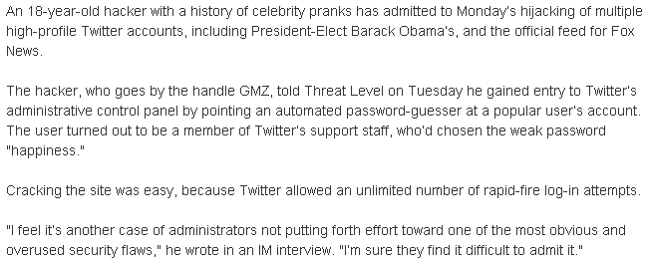
Real World Example - Twitter
Notes:
Even though this topic is engrained within the today’s culture and we all use overly strong passwords … right? … as developers we need to protect our applications from those that have not yet seen the light. Users continue to ignore guidance and set passwords that are easy to remember - and hence easy for an attacker to guess. In 2009 an 18 year old kid was able to guess (albeit with the help of a password cracker) the password of a Twitter support staff, giving the attacker access to Twitter's administrative control panel. From there it was trivial to hijack any number of user accounts, including the account of the President of the United States. What was the password? "happiness" Only slightly better than "123"! This should never have been allowed by the underlying code.

Slide 24
2010
In a report likely to make IT administrators tear out their hair, most users still rely on easy passwords, some as simple as "123456,“ to access their accounts. - Imperva Inc.
2012
Approximately 76 percent of attacks on corporate networks involved weak passwords. - Verizon RISK team "2013 Data Breach Investigations Report"
2013
During its penetration tests Trustwave collected 626,718 stored passwords and managed to recover more than half of them in minutes. 92 percent of the sample were able to be cracked in 31 days. - Trustwave
Notes:
Every year we think that the weak password issue will go away as users become more educated and aware of the problem. However, every year it continues to be a major problem.

Slide 25
Secure Coding …
Minimum password length = 8
Passwords must contain characters from three of the following four categories:
uppercase characters (A through Z)
lowercase characters (a through z)
base 10 digits (0 through 9)
non-alphabetic characters (for example, !, $, #, %)
Password must not contain the user's account name
Maximum password age = 6 months
Minimum password age = 1 day
Password history = 12 passwords remembered
Notes:
An organization may have the following corporate policy outlined on this slide. As developers, this policy should be enforced in our code wherever passwords are required. Our code should not allow our users to break corporate policy and put our systems at risk.
Note that ideally there would be some communication in the application with a shared corporate policy file so that if the policy changes the code itself doesn't fall out of date.

Slide 26
Authentication Words to Live By: #2
Implement an account lockout for failed logins
CWE-307: Improper Restriction of Excessive Authentication Attempts
The software does not implement sufficient measures to prevent multiple failed authentication attempts within in a short time frame, making it more susceptible to brute force attacks.
Notes:
The second of our words to live by is "implement an account lockout for failed logins". This corresponds to CWE-307 titled "Improper Restriction of Excessive Authentication Attempts". The goal here is to stop an attacker from being able to run through a long list of usernames and passwords in an attempt to brute force their way through.

Slide 27
Real World Example - Twitter
Notes:
In this real world example, the password cracker application was able to try a large number of potential passwords since there was no limit on the number of login attempts that could be made. Eventually, a valid password was discovered.

Slide 28
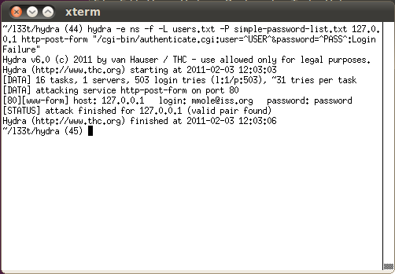
Password Basics – Exploit Demo
Open Source Tool: Hydra
Notes:
Demo: Demonstrate high level reconnaissance of the account creation page that leads to discovery of a valid email format (describe other ways this could be gained from Google). Explain the Hydra tool and how it can be used to process large password files against a defined list of users, running many parallel tasks to speed up the process. Use the example in example.txt to demonstrate it successfully popping the password on the application, and demonstrate successfully logging into the site.
Discuss the lack of complex composition requirements being part of the problem, combined with account lockout. Address the fact that lockout isn’t enough – a ‘reverse brute force’ can still try one password against many accounts.

Slide 29
1 int validateUser (char *host, int port)
2 {
3 int isValidUser = 0;
4
5 char username[USERNAME_SIZE];
6 char password[PASSWORD_SIZE];
7
8 while (isValidUser == 0)
9 {
10 if (getUserInput(username,USERNAME_SIZE) == 0) error();
11 if (getUserInput(password,PASSWORD_SIZE) == 0) error();
12
13 isValidUser = AuthenticateUser (username, password);
14 }
15
16 return(SUCCESS);
17 }
The validateUser() method will continuously check for a valid username and password without any restriction on the number of authentication attempts made.
Notes:
In this example, notice that the validateUser() method will continuously check for a valid username and password without any restriction on the number of authentication attempts made. This is a classic example of CWE-307.

Slide 30
Secure Coding …
1 int validateUser (char *host, int port)
2 {
3 int isValidUser = 0;
4 int count = 0;
5
6 char username[USERNAME_SIZE];
7 char password[PASSWORD_SIZE];
8
9 while ((isValidUser == 0) && (count < MAX_ATTEMPTS))
10 {
11 if (getUserInput(username,USERNAME_SIZE) == 0) error();
12 if (getUserInput(password,PASSWORD_SIZE) == 0) error();
13 isValidUser = AuthenticateUser (username, password);
14 count++;
15 }
16
17 if (isValidUser) return(SUCCESS);
18 else return(FAIL);
19 }
Notes:
To fix this code, we need to add a MAX_ATTEMPTS check to the loop and fail the validation if the maximum attempts is reached. Note that we still need to make sure an attacker can't just call validate() many times. There needs to be some type of lockout on the validate function after MAX_ATTEMPTS is reached. Some possible implementations are:
- Disconnecting the user after a small number of failed attempts
- Implementing a timeout
- Locking out a targeted account
- Requiring a computational task on the user's part.
One other point to make here is that developers should attempt to use established authentication routines when possible instead of creating their own. An established routine will most likely have these security features built-in and implemented correctly.

Slide 31
Real World Example - eBay
A famous example of this type of weakness being exploited is the eBay attack. eBay always displays the user id of the highest bidder. In the final minutes of the auction, one of the bidders could try to log in as the highest bidder three times. After three incorrect log in attempts, eBay password throttling would kick in and lock out the highest bidder's account for some time. An attacker could then make their own bid and their victim would not have a chance to place the counter bid because they would be locked out. Thus an attacker could win the auction.
Mitigations:
Shorten the length of account lockout
Don't show who the highest bidder is
Don't expose user id, only expose name
Name should never be used as a key
Notes:
Of course it is not always as simple as following the previous secure coding guidelines. In this example, eBay implemented password throttling to help protect against a brute force attack on a user's login. After some number of incorrect attempts the user's account would be locked for some set period of time before it was enabled again. This is exactly what one would want to do in most applications. However, in this instance, the account lockout feature actually opened eBay up to another type of attack. Individuals involved in an auction would wait until just before the auction was set to expire and then purposely attempt to log into the current high bidder's account the set number of times. Eventually that account would be locked and the individual would submit a new high bid. The previous high bidder might want to respond with another bid but would be unable to do so as their account is locked.
This example shows how security can be very complex and requires some careful thinking before applying any given mechanism. Developers must work closely with the design team in an attempt to make an application as secure as possible.

Slide 32
Authentication Words to Live By: #3
“Forgot my password” functionality can be a problem
CWE-640: Weak Password Recovery Mechanism for Forgotten Password
The software contains a mechanism for users to recover or change their passwords without knowing the original password, but the mechanism is weak.
Notes:
The third words to live by say "'forgot my password' functionality can be a problem". This corresponds to CWE-640 titled "Weak Password Recovery Mechanism for Forgotten Password". In this case we are drawing attention to the fact that developers often make mistakes in the logic behind this functionality. All too often we see cases where an application allows someone to change a password without asking for the original password first, thus enabling an attacker to take over an existing account. Another issue is that the strength of the recovery mechanism may not be as strong as the real password, in short enabling a much simpler path into the application.

Slide 33
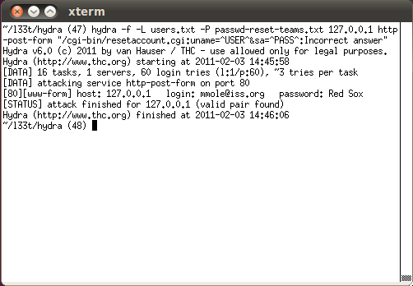
Password Reset – Exploit Demo
Open Source Tool: Hydra
Password reset is just a login – we can use the same tool!
Notes:
Demo: Demonstrate the choices for the account password reset available for user perusal in the account creation process. Point out that the questions are generally weak, because the answers often are from a small, finite list of possible answers. Show the passwd-reset-teams.txt file, noting how easy it is to put together a list of every available team of every major (and many minor) sport (courtesy of Wikipedia). Note that the password reset process is essentially just another “something you know” authentication challenge. Point out that this method almost never has an account lockout after a number of bad attempts. Given that this is just taking a user name and a security challenge answer, we can use the same Hydra tool to brute-force our way through this form as well.
Use the interface to provide the security answer, and show that the user can now directly set the password. Observe that since the application has the email address of the users, sending a one-time use password instead would be a better design. This way the attacker would also have to compromise the user’s email account in some manner to exploit the application. Note that the application should NEVER email the current password (since it should not be recoverable anyway, if stored correctly), but instead send a new strong password that must be changed after one use.

Slide 34
Real World Example – Yahoo!
Yahoo! email used three security questions:
Birthday
Zip code
Where she met her husband
Notes:
Just a few years ago, this issue was at the center of an attack on Sarah Palin. The hacker broke into her Yahoo! email account and then posted her email archives for all to see. How did he accomplish this? Well, he took advantage of a very weak password recovery mechanism. Yahoo! asked three questions of each user when they signed up. The answers to these questions (instances of "something you know") were used to authenticate a user is they happen to forget the password they has selected. Unfortunately the answers to these questions are not hard to find. The attacker easily got the first answer, got the second answer after a few guesses, and arrived at third answer after entering the name of the high school that Sarah and her husband attended: "Wasilla High".
Even if a strong password had been chosen, utilizing all four types of character complexity, an attacker only needs to know the answers to some simple questions to gain access.

Slide 35
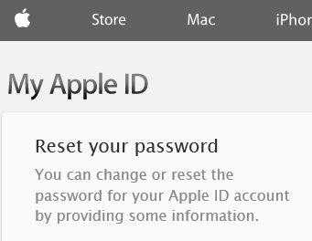
Real World Example – Apple iForgot
iforgot.apple.com – enter Apple ID
Select authentication method – “answer security questions”
Enter date of birth
Answer two security questions
Enter new password
Password is reset
Knowing someone’s Apple ID and DOB would allow construction of the URL after step #5.
--------
The exploit was published on the day that Apple launched two-factor authentication for Apple ID accounts, which would have prevented the attack for anyone that had enabled it. Once activated, the feature replaces the security question based verification with a 4-digit code sent to the user's mobile device
Notes:
Even major vendors get this wrong. Apple had an embarrassing hole in their password reset function that allowed an adversary to change a user’s password and take control of their account. An adversary just needed to “guess” easily obtainable answers. (e.g., date of birth) Note the change to two factor authentication just as an exploit was released. We will talk about this example again later in the class.
More information can be found at: http://www.imore.com/anatomy-apple-id-password-reset-exploit

Slide 36
Secure Coding …
Make sure any security question is hard to guess and hard to find the answer.
The system must only email the new password to the email account of the user resetting their password.
Assign a new temporary password rather than revealing the original password and force the user to set a new one.
Consider throttling the rate of password resets so that a legitimate user can not be denied service by an attacker that tries to recover the password in a rapid succession.
Notes:
There are a few guidelines to follow when developing the “forgot my password” functionality.
- Make sure any security question is hard to guess and hard to find the answer. As an example, a question asking about someone's favorite color would be easy to guess as there are only a handful of answers. Asking about their hometown is something that a little internet searching would probably uncover.
- The system must only email the new password to the email account of the user resetting their password.
- Assign a new temporary password rather than revealing the original password and force the user to set a new one.
- Consider throttling the rate of password resets so that a legitimate user can not be denied service by an attacker that tries to recover the password in a rapid succession.

Slide 37
Authentication Words to Live By: #4
For web applications, use and enforce POST method
CWE-598: Information Leak Through Query Strings in GET Request
The web application uses the GET method to process requests that contain sensitive information, which can expose that information through the browser's history, referers, web logs, and other sources.
Notes:
The fourth and final words to live by for the Authentication section is "for web applications, use and enforce POST method". This corresponds to CWE-598 titled "Information Leak Through Query Strings in GET Request". GET requests not only show information in the title bar of the browser, but they also lead to potentially sensitive information being stored in logs. One thing to note is that it’s not enough to just be explicit in your forms on the client (GET is often the default if you don’t specify the POST method), but you must also enforce in the server-side code to prevent mistakes and only allow POST requests to be processed. (Don't just forward a GET request to the POST handler.)

Slide 38
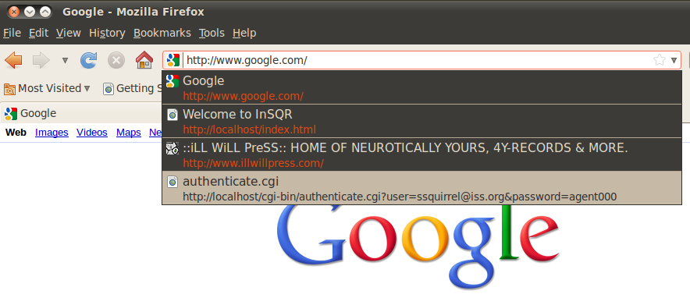
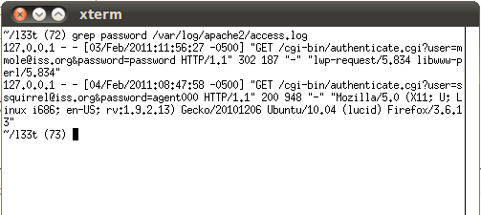
Password Disclosure – Exploit Demo
Notes:
Demo – Perform a grep on the Apache logs to pull some of the GET method examples of when passwords were sent to the server not using POST. It should pull up multiple examples from prior testing. The browser should also be able to be used to show an example of where it’s possible for a browser to cache copies of requests along with their query string information, which can result in an information disclosure.

Slide 39
Real World Example – Watchguard SSL-VPN
Notes:
In this example from 2008, the Watchguard's Fireware SSL-VPN Client was found to use a GET request during the connection process which unfortunately included the username and password. This means that both the username and password were stored in the webserver logs thereby exposing them to any admin of the system, or an attacker that was able to exploit some other vulnerability on the server in order to read the log. This problem became a big issue when it was discovered that a poor job of authentication was being done (the client didn't fully check the server certificate), enabling an attacker to impersonate the server. The fake server would receive real requests from clients that contained their real credentials. Since the credentials were sent using a GET request and is in the URL received by the attacker's fake server, the URL (and hence the credentials) were now in the logs that the attacker can read.
http://christophe.vandeplas.com/2009/08/watchguard-fireware-ssl-vpn_02.html

Slide 40
1 protected void doGet(...)
2 {
3 doPost(...) // forward request to doPost()
4 }
5
6
7 protected void doPost(...)
8 {
9 ProcessLoginRequest();
10 }
The above code forwards the GET request on to the doPost() handler. Even though the current client front end may not make a GET request, the door is now open for a future client or a custom client interacting with the server. If the page is dealing with information that shouldn't be leaked, then don't even allow for the possibility.
Notes:
The above code forwards the GET request on to the doPost() handler. Even though the current client front end may not make a GET request, the door is now open for a future client or a custom client interacting with the server. If the page is dealing with information that shouldn't be leaked, then don't even allow for the possibility.

Slide 41
Secure Coding …
1 protected void doGet(...)
2 {
3 throw new Exception("GET requests not allowed");
4 }
5
6
7 protected void doPost(...)
8 {
9 ProcessLoginRequest();
10 }
The above code does not allow a GET request and simply throws an error if one is received.
Notes:
To correct the previous code, throw an exception if a GET request is received. Do not even allow a GET request to be processed.
Technically, in this case the server will still log the GET request. But future developers that may try to build a client will not have success sending GET requests and will be forced to use a POST request to communicate to the server. As application devels, there isn't much we can do to stop a request from being sent, but we can make sure that our apps don't work when bad requests are sent and thus keep developers from using those flawed mechanisms.

